Slide 1
ERCOT Market Data Processing Improvements
Stephen Xu & Pranil Walke
07/19/2023

Slide 2
Moving away from excel based tool to new automated Python
Original version created in 2015
Transition from web scraping to API pull - 2021
“Planned” Retirement -2023
Evolution of MIS downloads (market data downloads)
Objective
Current State | Proposed State
Excel VBA Based | Python Based
Non-existent documentation | Detailed Documentation
Non-existent logging | Detailed emailing capability to help with troubleshooting
Doesn’t work for many folders | Should work for all folders with available data
Slow: Takes up to an hour | Fast: Aim for 7-8x Speedups

Slide 3

New Proposed Download Workflow
0. Simple pre-processing of the data
- 10 seconds
Pre-Processing
Attempt concurrent downloads to all folders
- 300 seconds
02_AAFRWP
03_ASC
04_BLPE
…
130-SSPSF
2. Try to fix all folders that failed to download
- 200 seconds
Error Handling
3. Write to a raw log file and send an email that parses the file to determine if the downloads were successful
- 30 seconds
Send final summary email

Slide 4
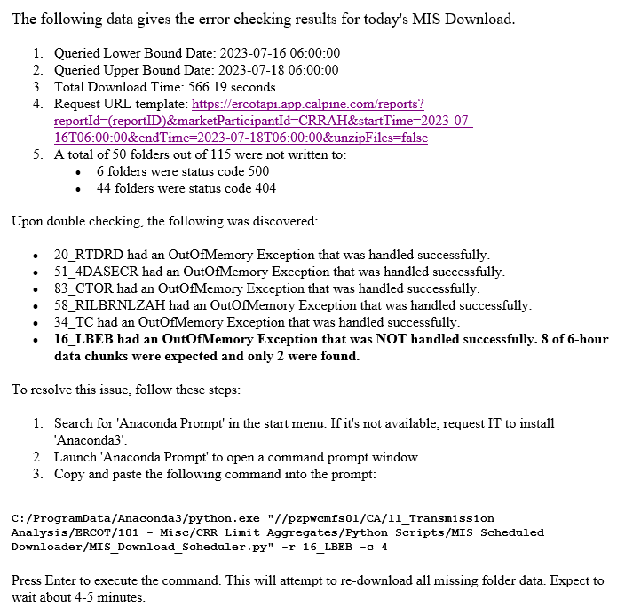
Error Checking Report Layout
Automated to send immediately after the data gets downloaded (roughly 6:25 AM)
Summarizes the following:
Lower and upper bounds for date queries
Total download time recorded
Identifies which folders have no available data
Notes which folders were not successfully downloaded to
Offers an easy solution via the Command Line to manually download missing data
Provides further Troubleshooting Tips and Tricks

